Slide 1
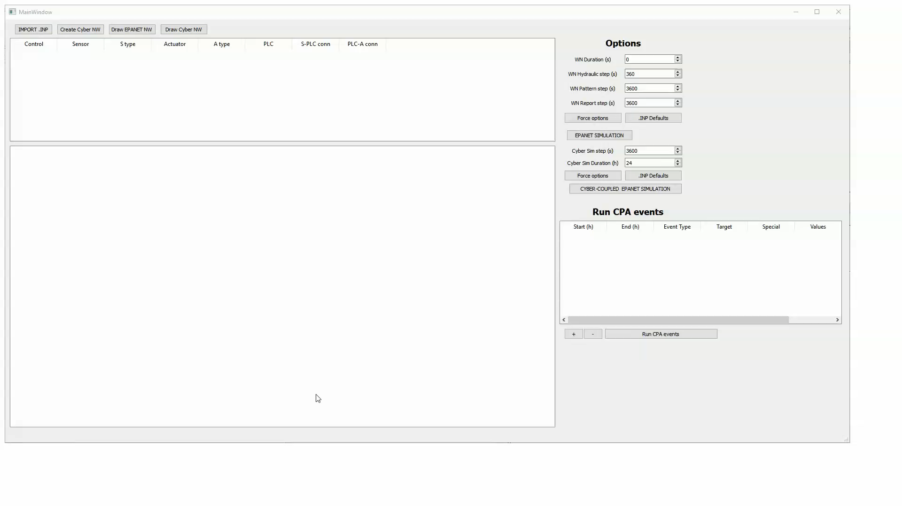
RISKNOUGHT interface (work in progress)
Nikolopoulos et al., RISKNOUGHT: A Cyber-Physical Stress-Testing Platform For Water Distribution Networks 11
Notes:
1

